Slide 1
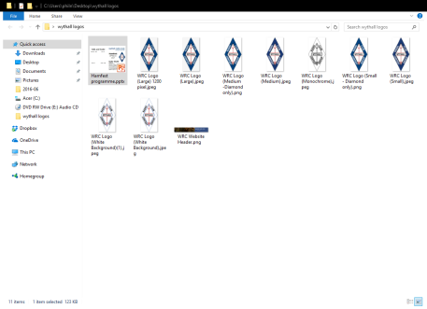



MAP inside
Halls and Traders
wythall radio club
“having fun with RF”
Britannia Room - Hall 1
Park Hall - Hall 2
Kevin Avery G3AAF Electronics
Howard Turner - Centre Electronics
Malvern Hills Repeater Group
John Dilks
Steve Smith G6OUX
Robin Bagnall Radio Receivers
RAIBC
Northampton Radio Club
DMR Expert
Kevin Kelly
Alan Clunnie- Sinotel
Chris Simmonds
Chris Walker & Ian Hewitt
Radioworld UK Ltd.
Worsley Communications
T K Electronics
Mickeys Electronics
Mirfield Electronics
Festival – J Dosher
Clive Walker M1MST
Ian Whittaker - Laptops and PC’s R Brough
Richard Newton G0EWH
Ron Carter
Kenneth Wilkins-Merrivale TV
Martin Matthews
…welcomes you to our…
2020 Hamfest
Sunday 15th March at Wythall House
Scout Hut- Hall 3
Archery Range – Hall 4
G0OJJ Vintage Radio
South Birmingham Radio Socy
Alan Clegg Valves
Geoff’s Bespoke Chassis & Crystal Receivers
fizzPOP Makerspace
Luke Kelly
Wythall Radio Club Stall
Bring & buy
RSGB Bookstall
David Long
MA Components
SARS (Solihull ARS)
Inter-Club GMT award presented by Solihull ARS (see back page)
…in association with…
MAll you need to know in Digital Two-Way Radio
td
All you need to know in Digital Two-Way Radio
Solihull ARS will be announcing the results of the first Midlands Inter-Club GMT award at 12 Noon, Archery Range (Hall4)
The overall winner will receive a radio,kindly donated by Martin Lynch & Sons.There is also a prize for the leading Foundation operator
Visit Dave, Annette & Sam at RadioWorld in Park Hall for the best bargains today!
www.radioworld.co.uk
wythall radio club “having fun with RF”

